Slide 1
Compare The Relationship Between Validation ‘Mean Square Error’ And Model Structure.
An experiment by Chia Hao Tang

Slide 2

How the model structure impact the accuracy?
In deep learning,we don’t know the precise rule between improving the accuracy and buliding the model structure.
In the reason,I want to test the relationship between the accuracy of each other under different neural network structures.

Slide 3

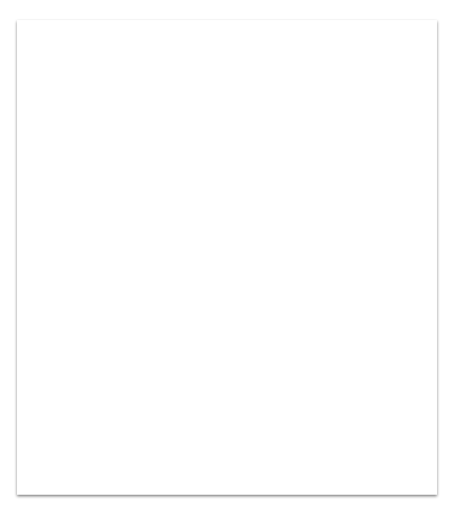
1. Setup
Experiment environment The data include 4 million+ PUBG player’s data,each data include 27 features and final ranking.
Test mode In model structure. We set the 4 different depth of hidden layer(1~4). each depth of hidden layer set 5 different number of neural network elements(50,100,150,200,250).
So we will test the 20(4*5)mode to compare the ‘mean square error’ of each mode.

Slide 4
Experiment environment
Our data include 4 million+ PUBG round’s data,each data include 27 features and final ranking which corresponding to each data. We will translate the ranking to score. (last ranking->0 and first ranking->1)
We split the 4 million+ data to 3 million+ data as training data and 1 million+ data as validation data.
Our goal is using training 3 million+ data to train the model and validate the validation data and take the difference between exact score(in data) and predict score(model predict). This difference also call validation mean square error,
In the experiment, we focus on the relation between each the model structure and its validation mean square error.
Tip
The data source is from Kaggle: https://www.kaggle.com/c/pubg-finish-placement-prediction

Slide 5
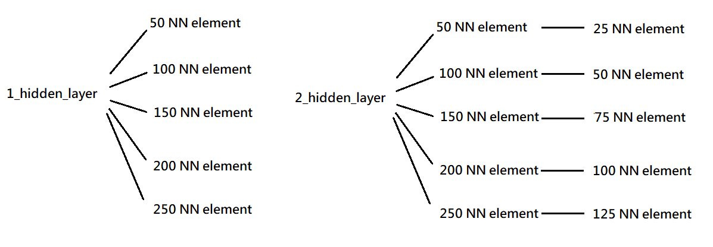
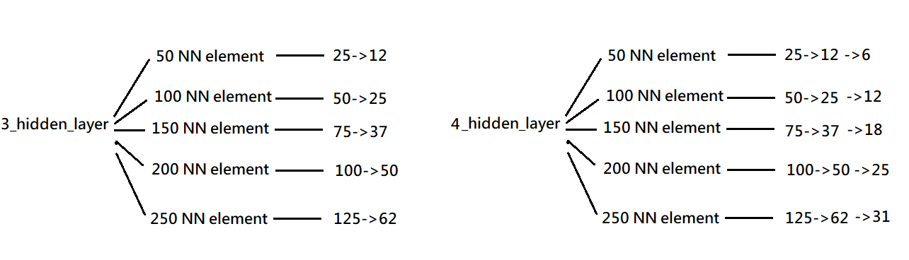
Test mode
In model structure. We set the 4 different depth of hidden layer(1~4). each depth of hidden layer set 5 different number of neural network elements(50,100,150,200,250).
So we will test the 20(4*5)mode to compare the ‘mean square error’ of each mode.
The samples of mode are :

Slide 6
2. Experiment Result
The bar graph
We use the bar graph to show the difference of validation mean square error of each mode.
The barh graph We use the barh graph to show the difference of validation mean square error of each mode.
The line graph
We use the line graph to show the difference of validation mean square error of each mode.

Slide 7
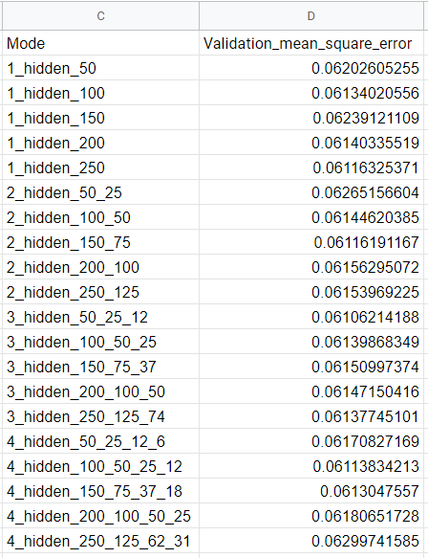

Experiment Result
The experimental results show that the values ​​are very close, and we will plot the 3 type graph(bar,barh,line).
Lowest error
Tip
Tell the audience about the problem through a story, ideally a person.

Slide 8
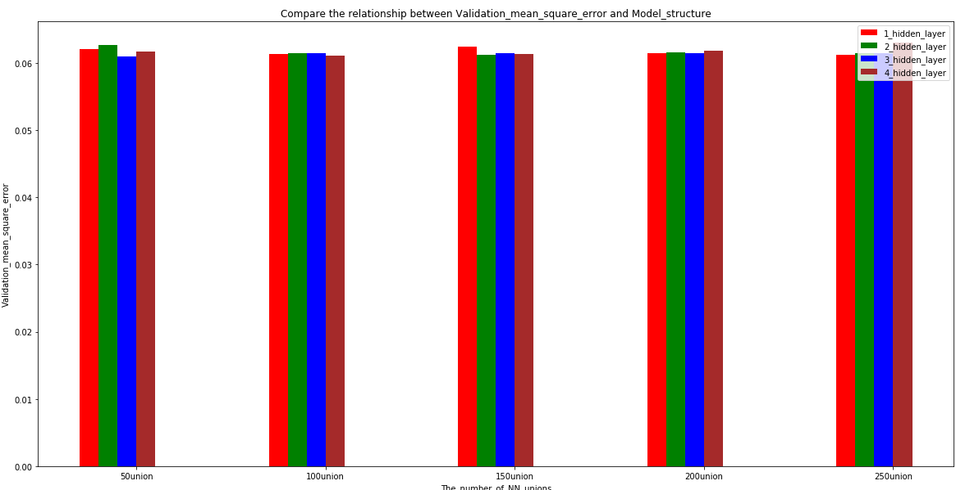
The bar graph
The minimum error occurs 3_hidden layer (50 25 12)

Slide 9
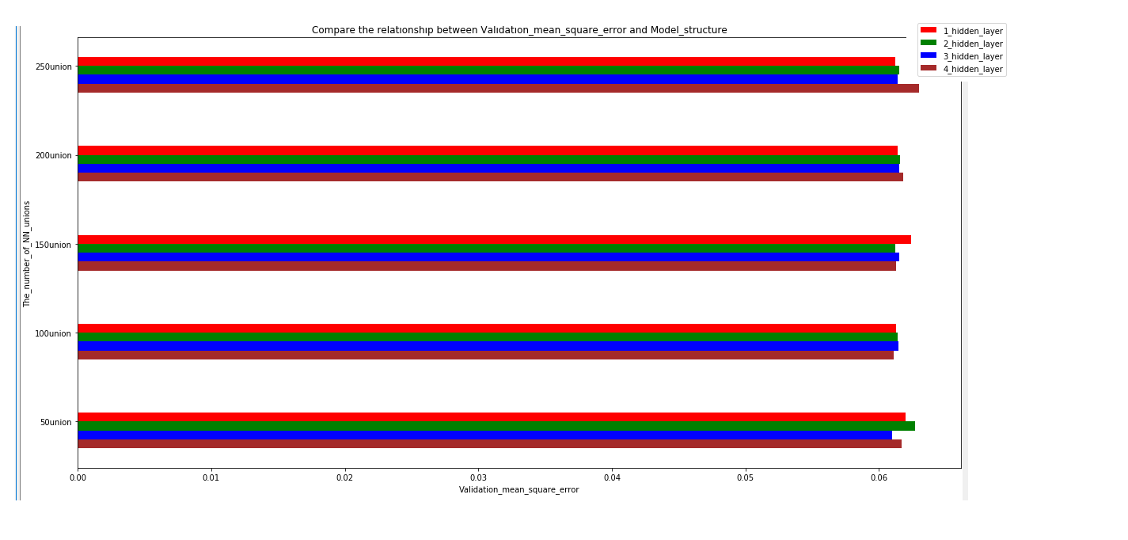
The barh graph
The minimum error occurs 3_hidden layer (50 25 12)

Slide 10
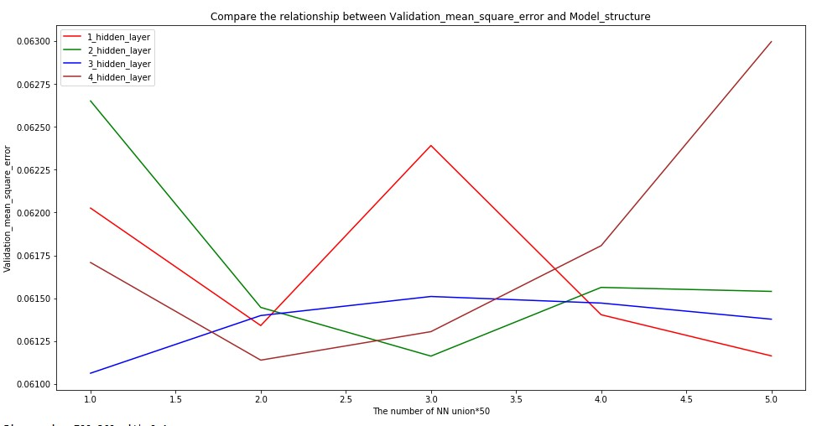
The minimum error occurs 3_hidden layer (50 25 12)

